Slide 1
Chapter 18
Application Case Study – Electrostatic Potential Map

Slide 2
A Common Sequential Computation Pattern
in
Double Nested Loop
iterate over output
iterate over input
out

Slide 3
A Simple Code Example
for (m = 0; m < M; m++) {
for (n = 0; n < N; n++) {
out[n] += f(in[m], m, n);
}
}
Input data “in”
M = # scan points
Output data “out”
N = # regularized scan points
Complexity is O(MN)
Output tends to be more regular than input
Notes:
The algorithms for Q and FHd are nearly identical, so in the interest of time we’ll examine only Q.
There are M scan points, with the 3D scan data represented by kx, ky, kz, and phi.
There are N pixels, with the 3D pixel data represented by x, y, and z (inputs) and Q (output).
As you can see, the algorithm is embarrassingly data-parallel.
Each iteration of the outer loop corresponds to a single point of scan data. For that single point of scan data, we first compute the magnitude-squared of phi. Then, the inner loop iterates over all the pixels, because the current scan data point contributes to the value of Q at every pixel. In other words, the value of Q at each pixel depends on every scan point. Clearly, the algorithm is O(MN).
Examining the inner loop more closely, we see that there are 10 floating-point arithmetic operations, 2 floating-point trig operations, and 10 loads. This instruction mix hints at the bottlenecks we face as we map this algorithm to the G80.

Slide 4
Scatter Parallelization
in
Thread 1
Thread 2
…
out

Slide 5
Scatter can be very slow.
All threads have conflicting updates to the same out elements
Serialized with atomic operations
Potentially very costly (slow) for large number of threads
Time
+
+
+
……
+
+
+
+
……
+
All threads update out[0]
All threads update out[1]

Slide 6
Gather Parallelization
in
Thread 1
Thread 2
…
Also called the
“Owner Computes” rule
out

Slide 7
Gather can be very fast.
All threads can read the same “in” elements
No serialization
Can even be efficiently consolidated through caches or scratchpad (shared) memories
+
+
+
Time
+
+
+
…
+
+
+
All threads update their own out elements, no need for atomics
+
+
+

Slide 8
Why is scatter parallelization often used rather than gather?
In practice, each in element does not affect all “out” elements
Output tends to be much more regular than input
It is easy to calculate all out elements affected by an in element
Harder to calculate all in elements needed for an out element
Easy thread kernel code if written in scatter

Slide 9
Challenges in Gather Parallelization
Regularize input elements so that it is easier to find all in elements that affect an out element
Cut-off Binning Lecture
For this lecture, we assume that all in elements affect all out elements

Slide 10
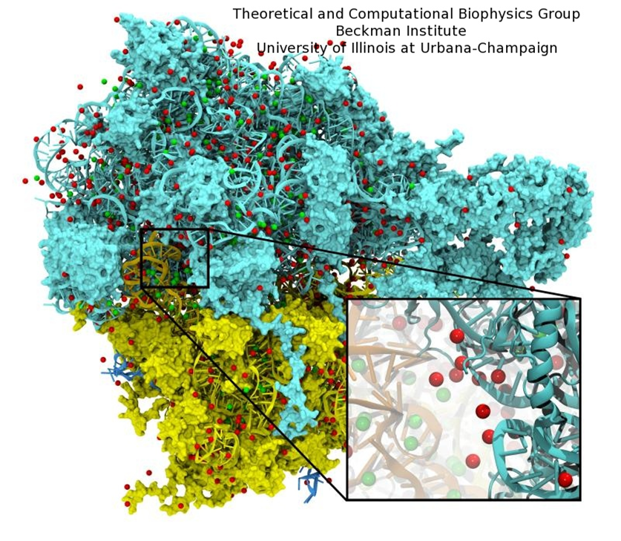
Example – Ion Placement in Molecular Modeling
Biomolecular simulations attempt to replicate in vivo conditions in silico
Model structures are initially constructed in vacuum
Solvent (water) and ions are added as necessary to reproduce the required biological conditions

Slide 11
Ion Placement Process (Step 1)
Calculate an initial electrostatic potential map around the simulated structure considering the contributions of all atoms
Very time consuming in VMD, focus of our example.
Lattice point being evaluated

Slide 12
Ion Placement Process (Step 2)
Ions are then placed one at a time:
Find the point with the minimum potential value
Add a new ion atom at location of minimum potential
Add the potential contribution of the newly placed ion to the entire map
Repeat until the required number of ions have been added

Slide 13
Overview of Direct Coulomb Summation (DCS) Algorithm
Most accurate way to compute the electrostatic potentials on a grid, ideally suited for the GPU
All atoms affect all map lattice points
For each lattice point, sum potential contributions for all atoms in the simulated structure:
potential += charge[i] / (distance to atom[i])
Approximation-based methods such as cut-off summation can achieve much higher performance at the cost of some numerical accuracy and flexibility
Will cover these later in the Binning Lecture

Slide 14
Direct Coulomb Summation (DCS) Algorithm Details
At each lattice point, sum potential contributions for all atoms in the simulated structure:
potential += charge[i] / (distance to atom[i])
Distance to Atom[i]
Lattice point being evaluated
Atom[i]

Slide 15
Electrostatic Potential Map Calculation Function Overview
Each call calculates an x-y slice of the energy map
energygrid – pointer to the entire potential map
grid – the x, y, z dimensions of the potential map
gridspacing – modeled physical distance between grid points
z – the z coordinate of the x-y slice being calculated
atoms – array of x, y, z coordinates and charge of atoms
numatoms – number of atoms in atoms array

Slide 16
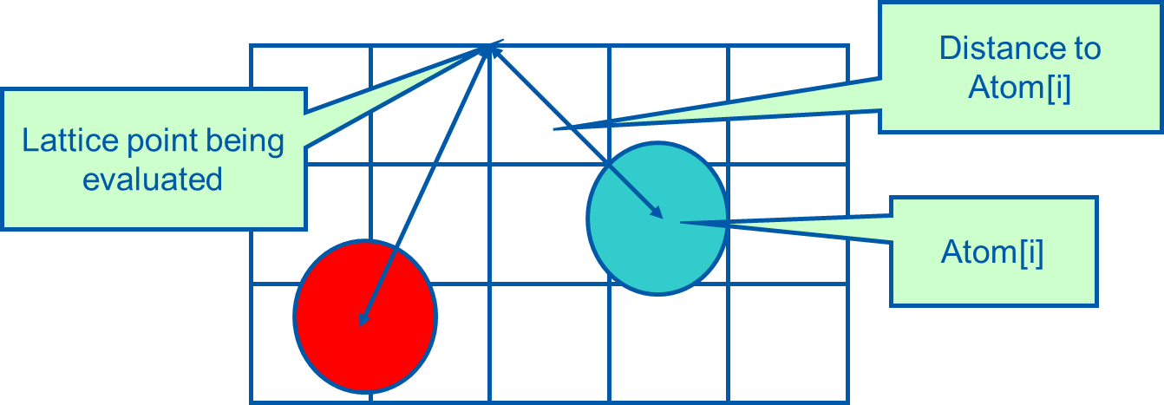
Electrostatic Potential Map Calculation Function Overview
Each call calculates an x-y slice of the energy map
energygrid – pointer to the entire potential map
grid – the x, y, z dimensions of the potential map
gridspacing – modeled physical dist between grid points
z – the z coordinate of the x-y slice being calculated
atoms – array of x, y, z coordinates and charge of atoms
numatoms – number of atoms in atoms array

Slide 17
Electrostatic Potential Map Calculation Function Overview
Each call calculates an x-y slice of the energy map
energygrid – pointer to the entire potential map
grid – the x, y, z dimensions of the potential map
gridspacing – modeled physical dist between grid points
z – the z coordinate of the x-y slice being calculated
atoms – array of x, y, z coordinates and charge of atoms
numatoms – number of atoms in atoms array

Slide 18
Electrostatic Potential Map Calculation Function Overview
Each call calculates an x-y slice of the energy map
energygrid – pointer to the entire potential map
grid – the x, y, z dimensions of the potential map
gridspacing – modeled physical dist between grid points
z – the z coordinate of the x-y slice being calculated
atoms – array of x, y, z coordinates and charge of atoms
numatoms – number of atoms in atoms array

Slide 19
Electrostatic Potential Map Calculation Function Overview
Each call calculates an x-y slice of the energy map
energygrid – pointer to the entire potential map
grid – the x, y, z dimensions of the potential map
gridspacing – modeled physical dist between grid points
z – the z coordinate of the x-y slice being calculated
atoms – array of x, y, z coordinates and charge of atoms
numatoms – number of atoms in atoms array

Slide 20
An Intuitive Sequential C Version
void cenergy(float *energygrid, dim3 grid, float gridspacing, float z, const float *atoms, int numatoms) {
int atomarrdim = numatoms * 4; //x,y,z, and charge info for each atom
for (int n=0; n<atomarrdim; n+=4){ //calculate potential contribution of each atom
float dz = z - atoms[n+2]; // all grid points in a slice have the same z value
float dz2 = dz*dz;
int grid_slice_offset = (grid.x*grid.y*z) / gridspacing;
float charge = atoms[n+3];
for (int j=0; j<grid.y; j++) {
float y = gridspacing * (float) j;
float dy = y - atoms[n+1]; // all grid points in a row have the same y value
float dy2 = dy*dy;
int grid_row_offset = grid_slice_offset+ grid.x*j;
for (int i=0; i<grid.x; i++) {
float x = gridspacing * (float) i;
float dx = x - atoms[n ];
energygrid[grid_row_offset + i] += charge / sqrtf(dx*dx + dy2+ dz2);
}
}
} }
Outer loop iterates over
all atoms
input oriented

Slide 21
An Intuitive Sequential C Version (cont.)
void cenergy(float *energygrid, dim3 grid, float gridspacing, float z, const float *atoms, int numatoms) {
int atomarrdim = numatoms * 4; //x,y,z, and charge info for each atom
for (int n=0; n<atomarrdim; n+=4){ //calculate potential contribution of each atom
float dz = z - atoms[n+2]; // all grid points in a slice have the same z value
float dz2 = dz*dz;
int grid_slice_offset = (grid.x*grid.y*z) / gridspacing;
float charge = atoms[n+3];
for (int j=0; j<grid.y; j++) {
float y = gridspacing * (float) j;
float dy = y - atoms[n+1]; // all grid points in a row have the same y value
float dy2 = dy*dy;
int grid_row_offset = grid_slice_offset+ grid.x*j;
for (int i=0; i<grid.x; i++) {
float x = gridspacing * (float) i;
float dx = x - atoms[n ];
energygrid[grid_row_offset + i] += charge / sqrtf(dx*dx + dy2+ dz2);
}
}
} }
For each atom
pre-calculate quantities that are invariant across all grid points in the slice

Slide 22
An Intuitive Sequential C Version (cont.)
void cenergy(float *energygrid, dim3 grid, float gridspacing, float z, const float *atoms, int numatoms) {
int atomarrdim = numatoms * 4; //x,y,z, and charge info for each atom
for (int n=0; n<atomarrdim; n+=4){ //calculate potential contribution of each atom
float dz = z -atoms[n+2]; //all grid points in a slice have the same z coordinate
float dz2 = dz*dz;
int grid_slice_offset = (grid.x*grid.y*z) / gridspacing;
float charge = atoms[n+3];
for (int j=0; j<grid.y; j++) {
float y = gridspacing * (float) j;
float dy = y - atoms[n+1]; // all grid points in a row have the same y value
float dy2 = dy*dy;
int grid_row_offset = grid_slice_offset+ grid.x*j;
for (int i=0; i<grid.x; i++) {
float x = gridspacing * (float) i;
float dx = x - atoms[n];
energygrid[grid_row_offset + i] += charge / sqrtf(dx*dx + dy2+ dz2);
}
}
} }
For each row in the x direction
precalculate the quantities that do not vary across all grid points in the row

Slide 23
An Intuitive Sequential C Version (cont.)
void cenergy(float *energygrid, dim3 grid, float gridspacing, float z, const float *atoms, int numatoms) {
int atomarrdim = numatoms * 4; //x,y,z, and charge info for each atom
for (int n=0; n<atomarrdim; n+=4){ //calculate potential contribution of each atom
float dz = z - atoms[n+2]; // all grid points in a slice have the same z value
float dz2 = dz*dz;
int grid_slice_offset = (grid.x*grid.y*z) / gridspacing;
float charge = atoms[n+3];
for (int j=0; j<grid.y; j++) {
float y = gridspacing * (float) j;
float dy = y - atoms[n+1]; // all grid points in a row have the same y value
float dy2 = dy*dy;
int grid_row_offset = grid_slice_offset+ grid.x*j;
for (int i=0; i<grid.x; i++) {
float x = gridspacing * (float) i;
float dx = x - atoms[n ];
energygrid[grid_row_offset + i] += charge / sqrtf(dx*dx + dy2+ dz2);
}
}
} }
For each grid point in the current row
calculate the contribution of potential from the current atom

Slide 24
Summary of Sequential C Version
Algorithm is input oriented
For each input atom, calculate its contribution to all grid points in an x-y slice
Output (energygrid) is very regular
Simple linear mapping between grid point indices and modeled physical coordinates
Input (atom) is irregular
Modeled x,y,z coordinate of each atom needs to be stored in the atom array
The algorithm is efficient in performing minimal calculations on distances, coordinates, etc.

Slide 25

Irregular Input vs. Regular Output
Atoms come from modeled molecular structures, solvent (water) and ions
Irregular by necessity
Energy grid models the electrostatic potential value at regularly spaced points
Regular by design

Slide 26
CUDA DCS Implementation Overview
Allocate and initialize potential map memory on host CPU
Allocate potential map slice buffer on GPU
Preprocess atom coordinates and charges
Loop over potential map slices:
Copy potential map slice from host to GPU
Loop over groups of atoms:
Copy atom data to GPU
Run CUDA Kernel on atoms and potential map slice on GPU
Copy potential map slice from GPU to host
Free resources

Slide 27
Straightforward CUDA Parallelization
Use each thread to compute the contribution of an atom to all grid points in the current slice
Scatter parallelization
Kernel code largely corresponds to CPU version with outer loop stripped
Each thread corresponds to an outer loop iteration of CPU version
numatoms used in kernel launch configuration host code

Slide 28
A Very Slow DCS Scatter Kernel!
void __global__ cenergy(float *energygrid, float *atoms, dim3 grid, float gridspacing, float z) {
int n = (blockIdx.x * blockDim .x + threadIdx.x) * 4;
float dz = z - atoms[n+2]; // all grid points in a slice have the same z value
float dz2 = dz*dz;
int grid_slice_offset = (grid.x*grid.y*z) / gridspacing;
float charge = atoms[n+3];
for (int j=0; j<grid.y; j++) {
float y = gridspacing * (float) j;
float dy = y - atoms[n+1]; // all grid points in a row have the same y value
float dy2 = dy*dy;
int grid_row_offset = grid_slice_offset+ grid.x*j;
for (int i=0; i<grid.x; i++) {
float x = gridspacing * (float) i;
float dx = x - atoms[n ];
energygrid[grid_row_offset + i] += charge / sqrtf(dx*dx + dy2+ dz2));
}
}
}
}

Slide 29
A Very Slow DCS Scatter Kernel!
void __global__ cenergy(float *energygrid, float *atoms, dim3 grid, float gridspacing, float z) {
int n = (blockIdx.x * blockDim .x + threadIdx.x) * 4;
float dz = z - atoms[n+2]; // all grid points in a slice have the same z value
float dz2 = dz*dz;
int grid_slice_offset = (grid.x*grid.y*z) / gridspacing;
float charge = atoms[n+3];
for (int j=0; j<grid.y; j++) {
float y = gridspacing * (float) j;
float dy = y - atoms[n+1]; // all grid points in a row have the same y value
float dy2 = dy*dy;
int grid_row_offset = grid_slice_offset+ grid.x*j;
for (int i=0; i<grid.x; i++) {
float x = gridspacing * (float) i;
float dx = x - atoms[n ];
energygrid[grid_row_offset + i] += charge / sqrtf(dx*dx + dy2+ dz2));
}
}
}
}
Needs to be done as an atomic operation

Slide 30
Atomic Operations in CUDA
Function calls that are translated into single instructions (a.k.a. intrinsics)
Atomic add, sub, inc, dec, min, max, exch (exchange), CAS (compare and swap)
Read CUDA C programming Guide 4.0 for details
Atomic Add
int atomicAdd(int* address, int val);
reads the 32-bit word old pointed to by address in global or shared memory, computes (old + val), and stores the result back to memory at the same address. The function returns old.

Slide 31
More Atomic Adds in CUDA
Unsigned 32-bit integer atomic add
unsigned int atomicAdd(unsigned int* address, unsigned int val);
Unsigned 64-bit integer atomic add
unsigned long long int atomicAdd(unsigned long long int* address, unsigned long long int val);
Single-precision floating-point atomic add (capability > 2.0)
float atomicAdd(float* address, float val);

Slide 32
Pros and Cons of the Scatter Kernel
Pros
Follows closely the simple CPU version
Good for software engineering and code maintenance
Preserves computation efficiency (coordinates, distances, offsets) of sequential code
Cons
The atomic add serializes the execution, very slow!

Slide 33
A Slower Sequential C Version
void cenergy(float *energygrid, dim3 grid, float gridspacing, float z, const float *atoms, int numatoms) {
int atomarrdim = numatoms * 4;
int k = z / gridspacing;
for (int j=0; j<grid.y; j++) {
float y = gridspacing * (float) j;
for (int i=0; i<grid.x; i++) {
float x = gridspacing * (float) i;
float energy = 0.0f;
for (int n=0; n<atomarrdim; n+=4){//calculate potential contribution of each atom
float dx = x - atoms[n ];
float dy = y - atoms[n+1];
float dz = z - atoms[n+2];
energy += atoms[n+3] / sqrtf(dx*dx + dy*dy + dz*dz);
}
energygrid[grid.x*grid.y*k + grid.x*j + i] += energy;
}
}
}
output oriented
Outer loops iterate over all output grid points
Pre-calculate x and y coordinate of the grid point

Slide 34
A Slower Sequential C Version
void cenergy(float *energygrid, dim3 grid, float gridspacing, float z, const float *atoms, int numatoms) {
int atomarrdim = numatoms * 4;
int k = z / gridspacing;
for (int j=0; j<grid.y; j++) {
float y = gridspacing * (float) j;
for (int i=0; i<grid.x; i++) {
float x = gridspacing * (float) i;
float energy = 0.0f;
for (int n=0; n<atomarrdim; n+=4){//calculate potential contribution of each atom
float dx = x - atoms[n ];
float dy = y - atoms[n+1];
float dz = z - atoms[n+2];
energy += atoms[n+3] / sqrtf(dx*dx + dy*dy + dz*dz);
}
energygrid[grid.x*grid.y*k + grid.x*j + i] += energy;
}
}
}
y and z distances for an atom re-calculated
for all grid points More redundant work

Slide 35
Pros and Cons of the Slower Sequential Code
Pros
Fewer accesses to the energygrid array
Simpler code structure
Cons
More calculations on the coordinates
More accesses to the atom array
Overall, much slower sequential execution due to the larger number of calculations performed

Slide 36
DCS CUDA Block/Grid Decomposition (no thread coarsening)
Grid of thread blocks:
Thread blocks:
64-256 threads
0,0
0,1
…
1,0
1,1
…
Threads compute
1 potential each
…
…
…
Padding waste

Slide 37
A Fast DCS CUDA Gather Kernel
void __global__ cenergy(float *energygrid, dim3 grid, float gridspacing, float z, float *atoms, int numatoms) {
int i = blockIdx.x * blockDim.x + threadIdx.x;
int j = blockIdx.y * blockDim.y + threadIdx.y;
int atomarrdim = numatoms * 4;
int k = z / gridspacing;
float y = gridspacing * (float) j;
float x = gridspacing * (float) i;
float energy = 0.0f;
for (int n=0; n<atomarrdim; n+=4) { // calculate potential contribution of each atom
float dx = x - atoms[n ];
float dy = y - atoms[n+1];
float dz = z - atoms[n+2];
energy += atoms[n+3] / sqrtf(dx*dx + dy*dy + dz*dz);
}
energygrid[grid.x*grid.y*k + grid.x*j + i] += energy;
}
one thread per grid point

Slide 38
A Fast DCS CUDA Gather Kernel
void __global__ cenergy(float *energygrid, dim3 grid, float gridspacing, float z, float *atoms, int numatoms) {
int i = blockIdx.x * blockDim.x + threadIdx.x;
int j = blockIdx.y * blockDim.y + threadIdx.y;
int atomarrdim = numatoms * 4;
int k = z / gridspacing;
float y = gridspacing * (float) j;
float x = gridspacing * (float) i;
float energy = 0.0f;
for (int n=0; n<atomarrdim; n+=4) { // calculate potential contribution of each atom
float dx = x - atoms[n ];
float dy = y - atoms[n+1];
float dz = z - atoms[n+2];
energy += atoms[n+3] / sqrtf(dx*dx + dy*dy + dz*dz);
}
energygrid[grid.x*grid.y*k + grid.x*j + i] += energy;
}
All threads access all atoms in same order
Consolidated writes to grid points

Slide 39
Additional Comments
Further optimizations
dz*dz can be pre-calculated and sent in place of z
Gather kernel is much faster than a scatter kernel
No serialization due to atomic operations
Compute efficient sequential algorithm does not translate into the fast parallel algorithm
Gather vs. scatter is a big factor
But we will come back to this point later!

Slide 40
Even More Comments
In modern CPUs, cache effectiveness is often more important than compute efficiency
The input oriented (scatter) sequential code actually has very bad cache performance
energygrid[] is a very large array, typically 20+ times larger than atom[]
The input oriented sequential code sweeps through the large data structure for each atom, trashing cache.
The fastest sequential code is actually an optimized output-oriented code

Slide 41
Outline of A Fast Sequential Code
for all z {
for all atoms {precompute dz² }
for all y {
for all atoms {precompute dy² (+ dz²) }
for all x {
for all atoms {
compute contribution to current x,y,z point
using precomputed dy² and dz²
}
}
}
}
Need additional pre-computed arrays

Slide 42
More Thoughts on Fast Sequential Code
Needs temporary arrays for pre-calculated dz² and dy² + dz² values
So, why does this code have better cache behavior on CPUs?

Slide 43
More Thoughts on Fast Sequential Code
Needs temporary arrays for pre-calculated dz² and dy² + dz² values
So, why does this code have better cache behavior on CPUs?
Answer: the atom data structure is much smaller than the grid structure in practice.
Sweeping the atom data structure multiple times is more efficient since each sweep will likely find the data that was brought into cache by the previous sweep.
Writing high performance sequential code or parallel code is an engineering design effort, the tradeoffs often depends on data sizes

Slide 44
References
Wen-mei W. Hwu, David B. Kirk, and Izzat El Hajj. Programming Massively Parallel Processors: A Hands-on Approach. Morgan Kaufmann, 2022.

